Slide 1
INTERNSHIP TASK -1
PUSH BUTTON COUNTER
KEVIN VICTOR Intern ID : CTIS8913

Slide 2
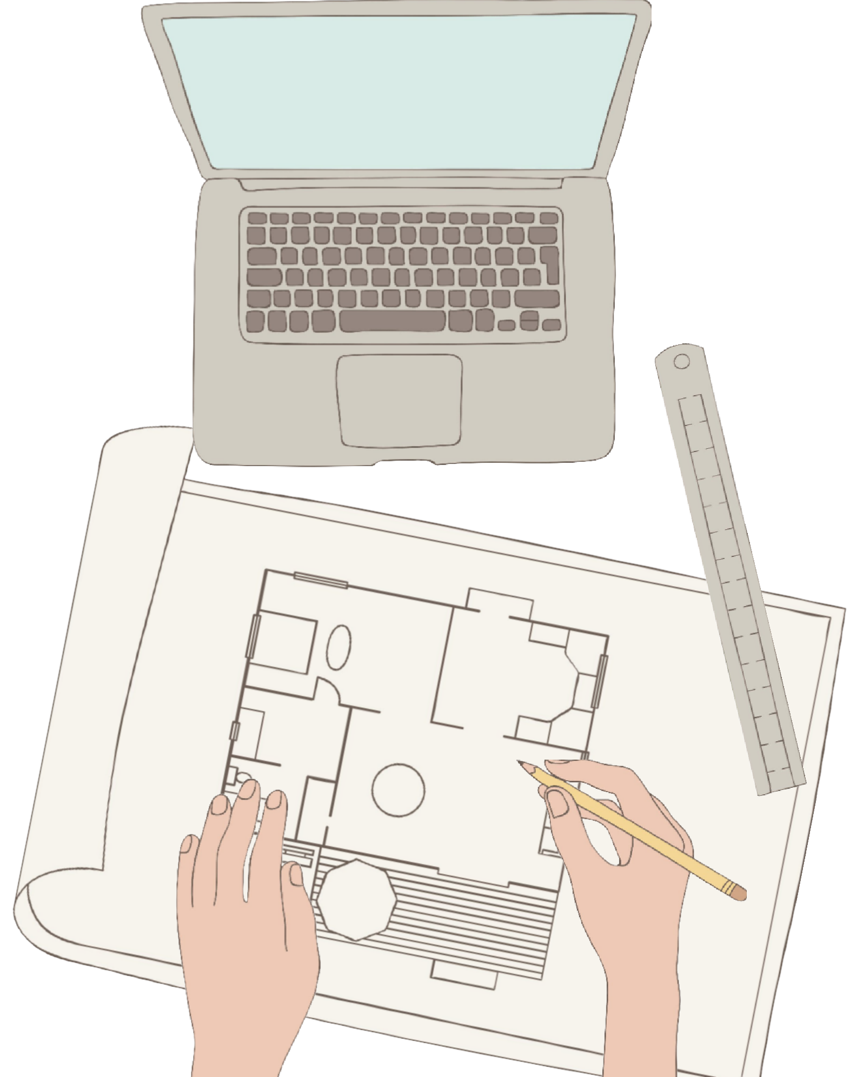
TASK `1
USE A TEMPERATURE SENSOR TO READ AND DISPLAY TEMPERATURE DATA ON AN LCD OR SERIAL MONITOR.

Slide 3
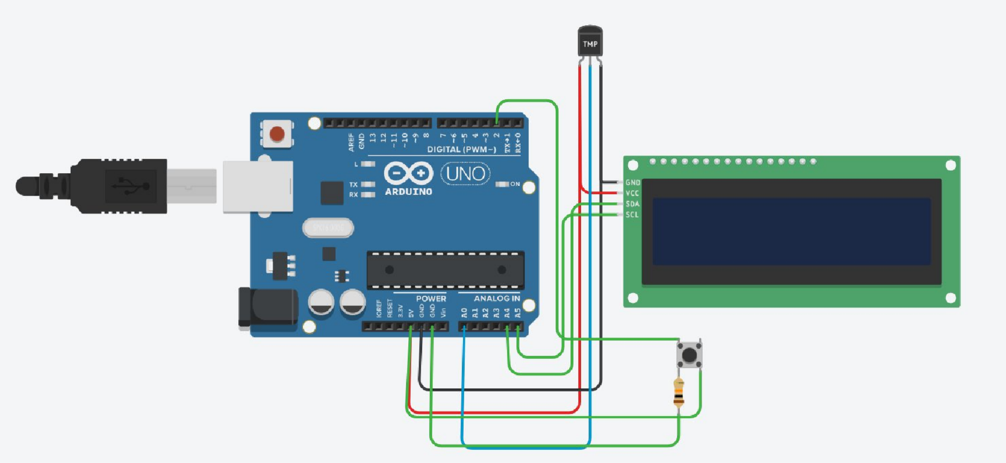
CIRCUIT DESIGN
Components
1.Temperature sensor
- TMP36
1.Arduino Uno R3
1.lcd ( 16 X 2 )
1. Resistor ( 10 k ohm)
1. Push Button

Slide 4
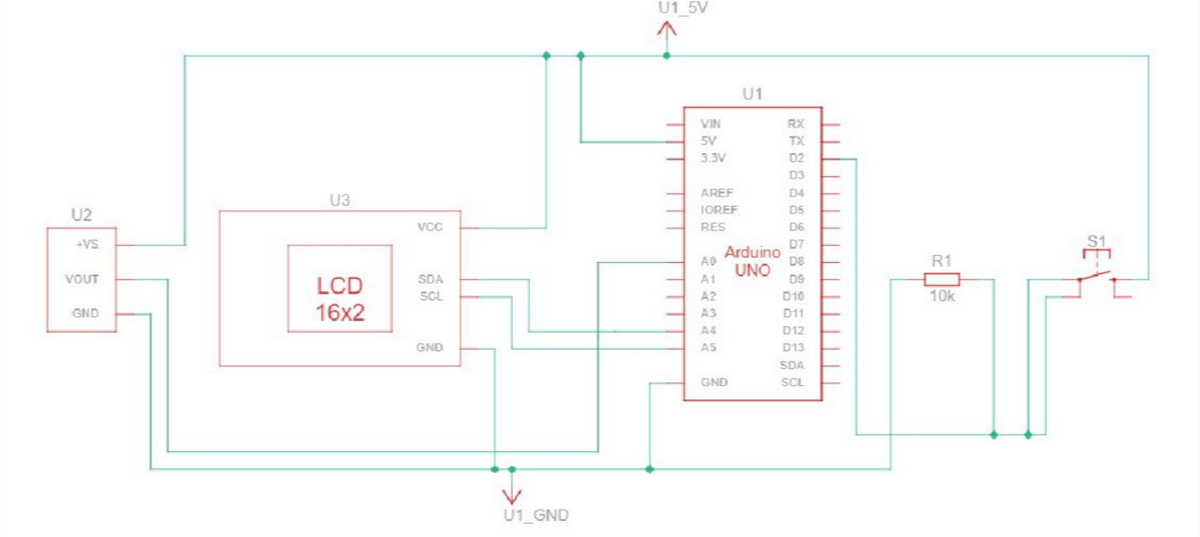
SCHEMATIC VIEW

Slide 5
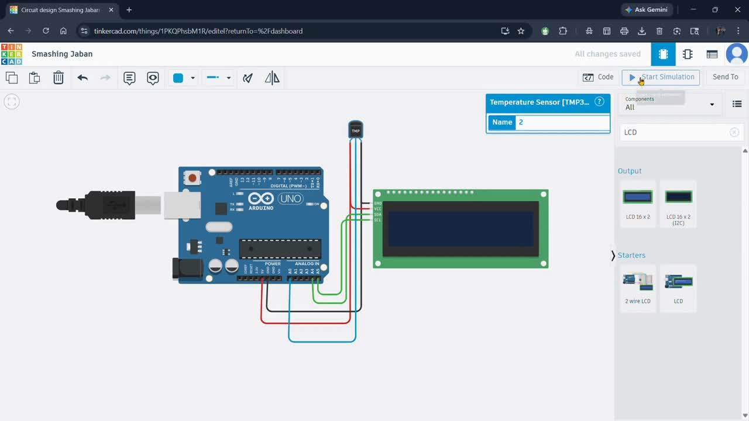
OUTPUT DEMONSTRATION

